Slide 1
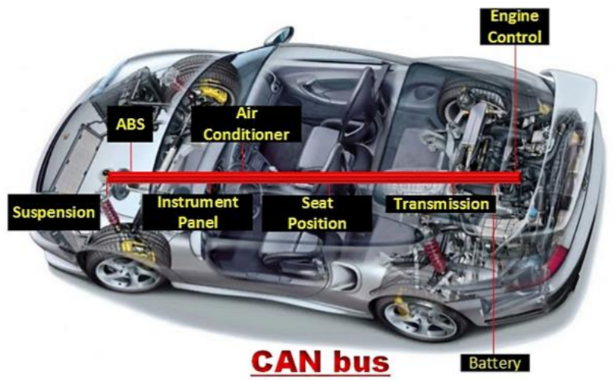
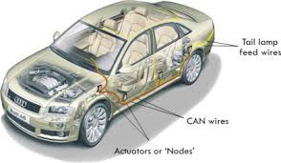
EXPLOITING THE CAN BUS

Slide 2
Submitted Under the Guidance of Dr. S.G
Bhirud by
Rushabh Patel (131070005)
Siddhant Shah (131070010)
Abhijit Gupta (131070014)
Mehul Jain (131070051)

Slide 3
Contents
Problem Statement
Introduction and Importance of CAN Bus
Data Frames of CAN Bus
Working of Arbitration in CAN Bus
Types of Attacks in CAN Bus
Prevention of Attack in CAN Bus
Our Plans

Slide 4
Problem Statement
The project is based on attacking , prevention and detection of CAN Bus.
Lack of security in the protocol of one of the most upcoming technologies - automated cars - motivated us to undertake this project.
Developing an authentication scheme that would add a logical layer of security over the protocol without affecting the timeliness of the messages would be our ultimate goal.
As an extended domain, we will also be detecting intrusion using deep neural networks.

Slide 5
What is CAN Bus ?
A vehicle bus to allow microcontrollers and devices to communicate directly with each other.
Designed for multiplex electrical wiring within automobiles.
CAN network used in many everyday products.
It replaces the traditional architecture of wiring with a new architecture consisting of only one bus, the CAN bus.

Slide 6












Applications of CAN Bus
Railways, Ships & Marine
Automotive
Construction Equipments
CAN
Building Automation
Medical Equipments
Industrial Automation

Slide 7
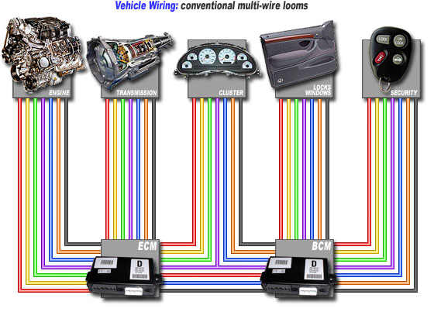
How it worked before
CAN Bus

Slide 8
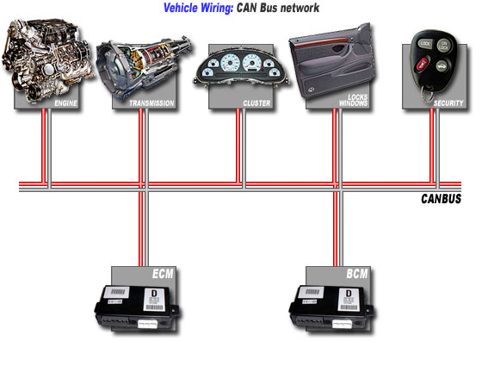
How it works after CAN Bus
Notes:
after

Slide 9

Advantages of CAN Bus
Advantages of
CAN Bus
conventional
cabling
over
Less wires
Less connections
Less weight
Less EMI problems
Less space requirements Easier addition of new nodes Lower assembly costs
Increased transmission reliability

Slide 10
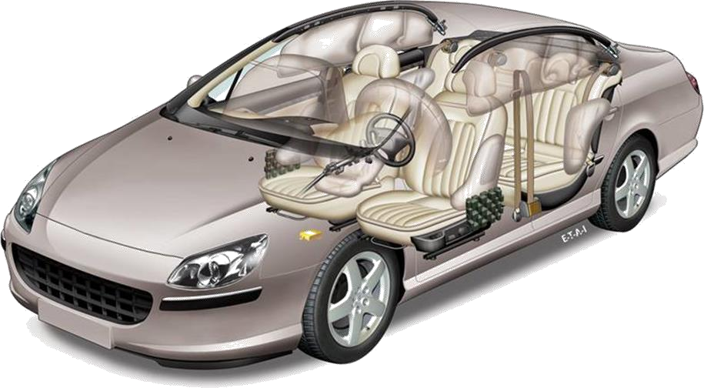
Examples for CAN in Automotive
High Speed
500-1000 [Kbit/s]
-Engine
-Brakes
-Gearbox
Low Speed
25-125
[Kbit/s]
-Central locking system
-Air conditioning
-Lights

Slide 11
Bus stations (Nodes)
Typically 3 to 40 nodes per bus
No limit for node number defined in CAN specification.
Number of nodes depends on capabilities of CAN transceivers.
Bus load usually gets higher with more nodes.
Hot plug-in / plug-out
Connect / disconnect nodes while the bus is up and running.

Slide 12
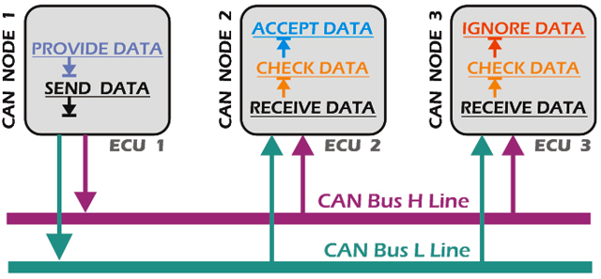
A Brief Overview of Working of CAN
Notes:
Broadcasting technique is the main aspect of CAN Bus.

Slide 13
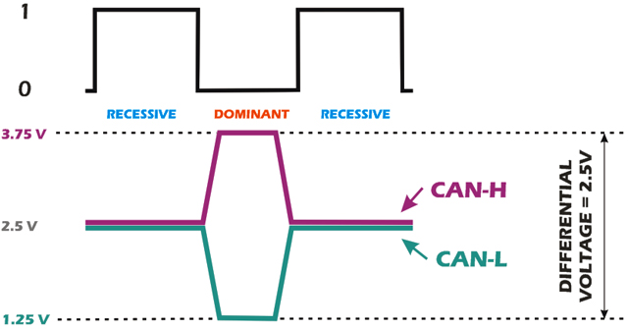
CANH and CANL
Notes:
How does CANH and CANL work?
And why do we need CANH and CANL ?

Slide 14




Data Frames : Format
Standard Format ( CAN 2.0A ): 11-bit identifier
Bus Idle Arbitration Field
Control Data Field CRC Field
Field
Ack End of Inter-
Bus Idle
Field Frame
frame Space
Field
recessive
S
R I r
D A D
Bus Idle
^{O} 11-bit Identifier ^{T D 0} DLC
0..64 Bit Data
15-bit CRC
^{E C E} 7-bit EOF IFS
Bus Idle
dominant
F
R E
L K L
Extended Format ( CAN 2.0B ): 29-bit identifier
Bus Idle
Arbitration field
Control Field
Data Field
CRC Field
Ack End of
Inter- Bus Idle
Field Frame
frame Space
Field
recessive
S
S I
R r r
D A D
Bus Idle
^{O} 11-bit Base Id
^{R D} 18-bit Ext. Id ^{T 1 0} DLC 0..64 Bit Data 15-bit CRC ^{E C E} 7-bit EOF IFS Bus Idle
dominant
F
R E
R
L K L
Notes:
Data frame structure
CAN standard implements four types of frames:
Data frame: a frame containing node data for transmission
Remote frame: a frame requesting the transmission of a specific identifier
Error frame: a frame transmitted by any node detecting an error
Overload frame: a frame to inject a delay between data and/or remote framee

Slide 15
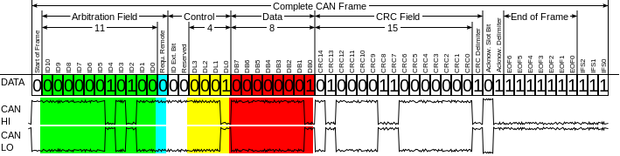
Encoding of bits on CANH and CANL
Notes:
https://en.wikipedia.org/wiki/CAN_bus#Frames

Slide 16
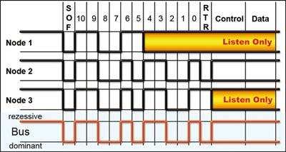
Working of Arbitration in CAN
Notes:
Working starts here -
Arbitration in canbus

Slide 17
How to Exploit CAN BUS ?
Level 1: Prevent ECUs from being compromised
Level 2: Protect the vehicle’s internal network against a compromised ECU
Level 3: Detect the compromise of an ECU

Slide 18
Security Requirements
Message Authentication
Replay Attack Resistance
Backward Compatibility
Small Communication Overhead and minimum re-formatting of messages.
Light computation and low memory consumption.
Notes:
Message authentication
It is required to make sure that the message has been sent from a trusted node.
Replay attack resistance
Re-sending a previously sent message should lead to the message being discarded by all its receivers.
Group keys
It is possible to use the same key for authenticating a group of messages.
Backward compatibility
Nodes supporting authentication can co-exist with old nodes not supporting authentication.

Slide 19
Why is it easy to Exploit CAN Bus ?
A CAN frame has no authentication field.
There is no authentication performed on the sender and receiver of a particular frame.
The data field size in a CAN frame is only 8 bytes long, making it difficult to add large-key security measures.
ECUs do not always have the computational power necessary to perform cryptographic functions
Besides, CAN is NOT poorly designed

Slide 20
Types of Attacks
Denial of Service (DoS)
Replay Attack
Injection/Diagnostics Attack
Notes:
injection-
trusted network
all trffic visible to all controllers
any controller can send any message
diag-
firmware upload, modifying variables, provide access to protected services
security access key brute-force

Slide 21
Prevention of Attacks
Two ways
Encryption
Authentication

Slide 22
Encryption
Symmetric Key (Shared Key)
easily implemented
easily decrypted due to small data size
Asymmetric Key (Public-Private Key)
secure
heavy computation
Random Data Problem
Notes:
heavy computation - RSA,AES
Random Data Problem - random data sent to controllers will decrypt to generate random command which will cause byzantine behaviour of the device.

Slide 23
Authentication Scheme
Authentication through Random Keys
One Master Controller
Every authorized device will have a variable named ‘nonce’
nounce acts as a shared key
Assumptions:
During initialization only authorized devices are connected

Slide 24
Initialization
The master node broadcasts a setup data frame containing a randomly generated nonce
This nonce is received and stored by all the devices connected to the CAN bus

Slide 25
Working
The sending device will create an HMAC of the data along with the nonce as the key
This HMAC would be attached to the data frame and broadcasted onto the CAN bus
The receiving device will authenticate the data in the same way
If the data frame is verified, the command is executed

Slide 26
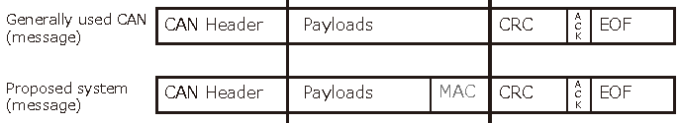
Random Key ‘nonce’
The nonce in a controller increases by 1 whenever an authenticated message is received
As the architecture of CAN bus uses a broadcasting technique, the nonce of all the authorized devices remains synchronized

Slide 27
Advantages
Due to the use of HMAC, concrete authentication technique can be implemented
As the HMAC is structured to create a small-sized output, the latency might not be much
The use of varying nonce, replay attack can be prevented as replay of frames would result in a mismatch of hashed nonce.

Slide 28
Disadvantages
Corruption of a single ECU will lead to complete reinitialization.
Technical support and addition of a new ECU for the vehicle would require a complete system setup.

Slide 29
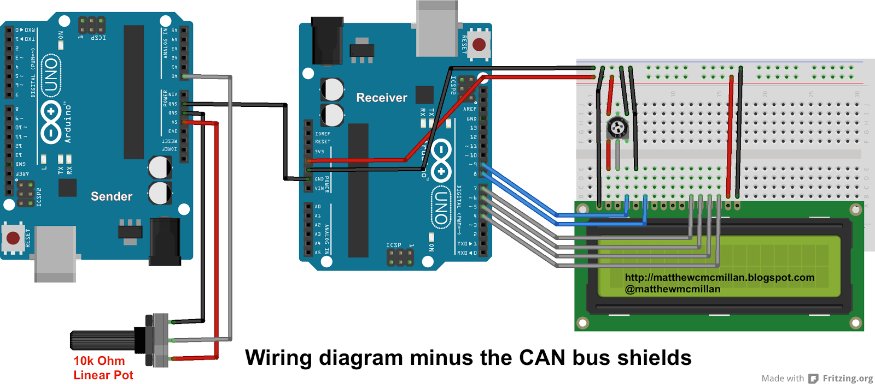
Hardware Requirements

